Slide 1
CDS-Hooks

Slide 2
CDS-Hooks – When I’m asked
SMART on FHIR
→ App Store for Medicine
CDS-Hooks
→ Google Maps - Turn by Turn Navigation

Slide 3
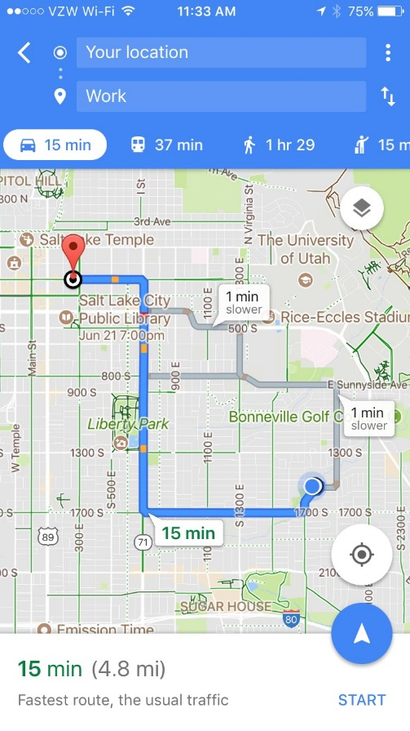
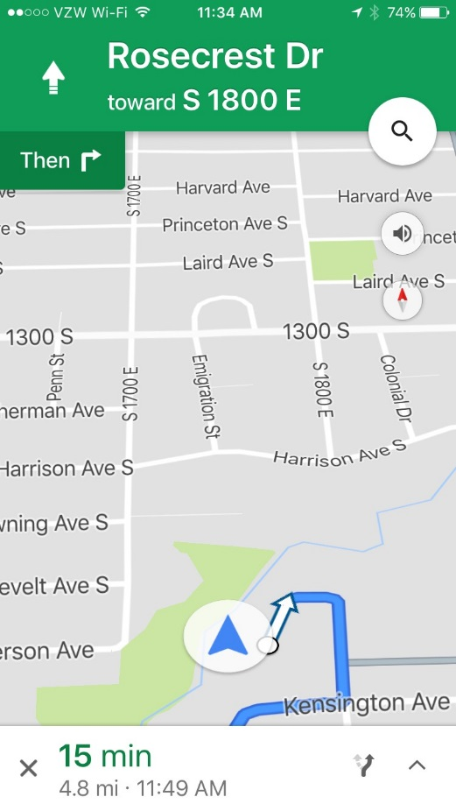
Turn by Turn Navigation is Decision Support
Delivers the perfect amount of information at exactly the right time
Based on latest relevant data
You’re always in control
Adapts to you
Allows for choice and configurability
Provides supplemental information
An intuitive user experience
Helps you reach a destination in the fastest and most cost effective fashion
Competition will continue to drive innovation
Notes:
Timing
Decision support at exactly the right moment
Fork in the road (L or R?)
In a ½ mile
Stay in the middle lane
Information
Incorporates the latest data (traffic, incidents)
Business hours, tells you if you’ll be late
Control
You’re still in control
Doesn’t steer the car for you, advice only
Doesn’t prevent you from taking alternatives, using your judgement
Adaptation
it continually adapts to you.
It knows where you are
Reroutes automatically as needed.
Supplements
Lots of supplemental data;
estimated time of arrival, points of interest, etc
Choice and Configurability
car, walking, biking, public transit
Easily “override” the recommended route

Slide 4
CDS-Hooks
“The most profound technologies are those that disappear. They weave themselves into the fabric of everyday life until they are indistinguishable from it”
Mark Weiser, Chief Technology Officer, Xerox

Slide 5
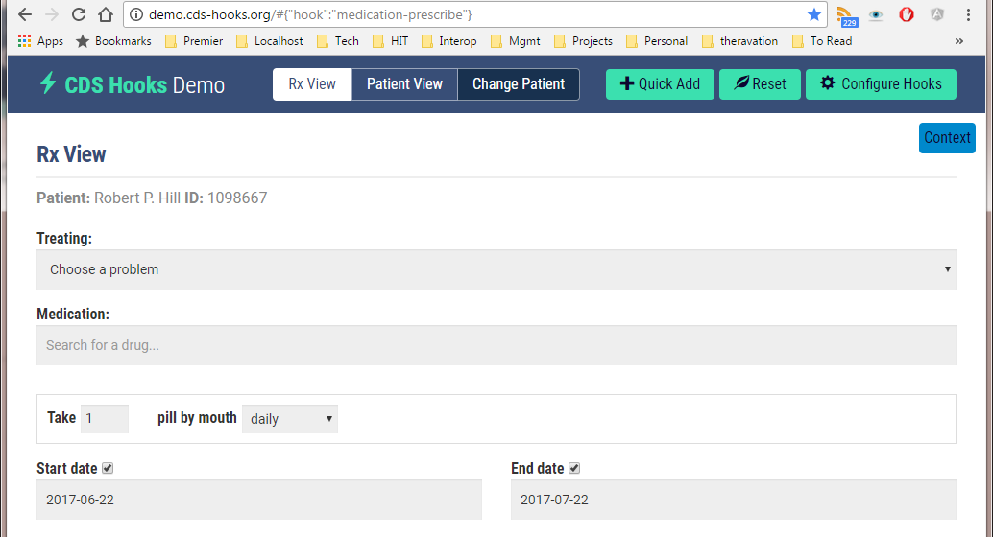

Slide 7
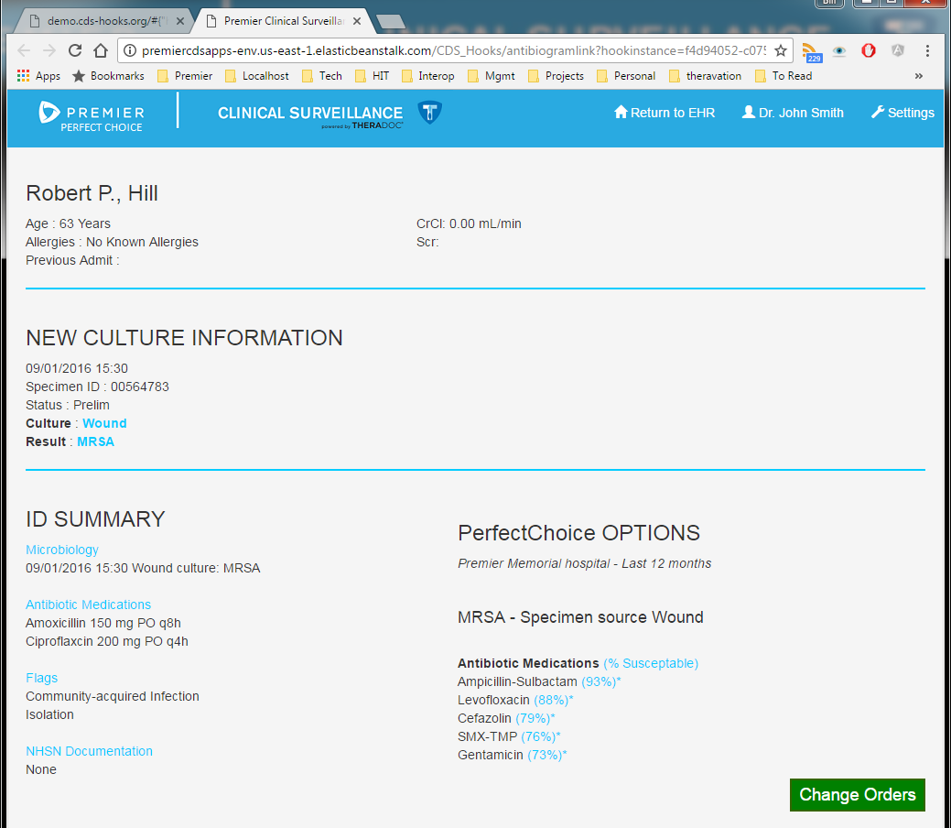

Slide 8
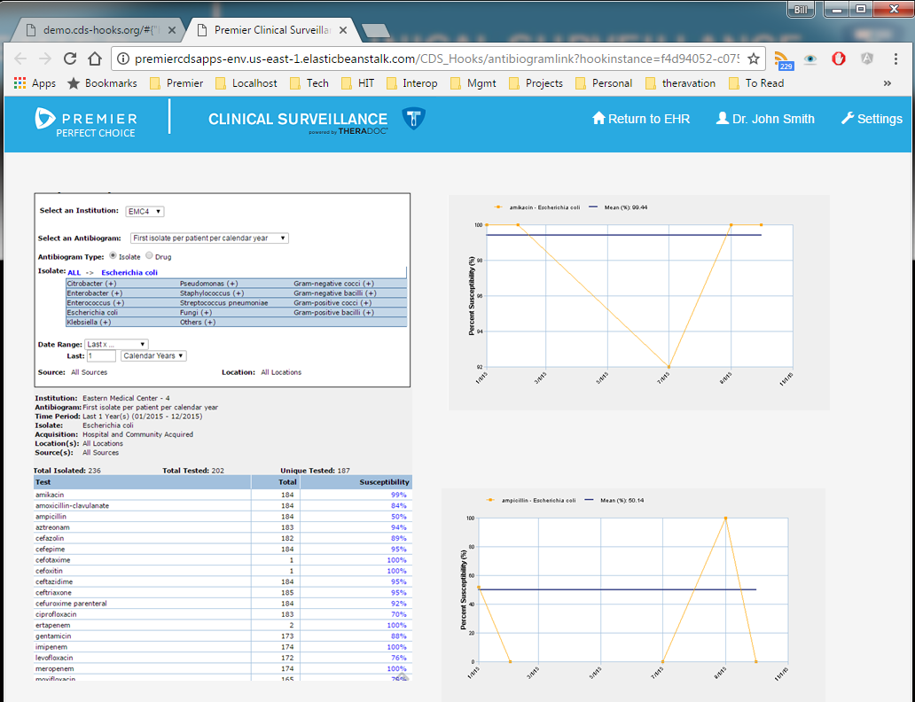

Slide 9
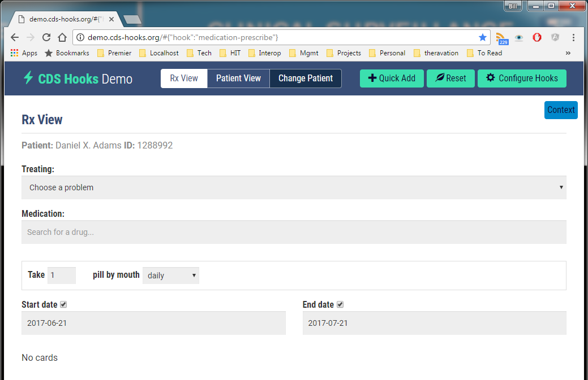

Slide 10
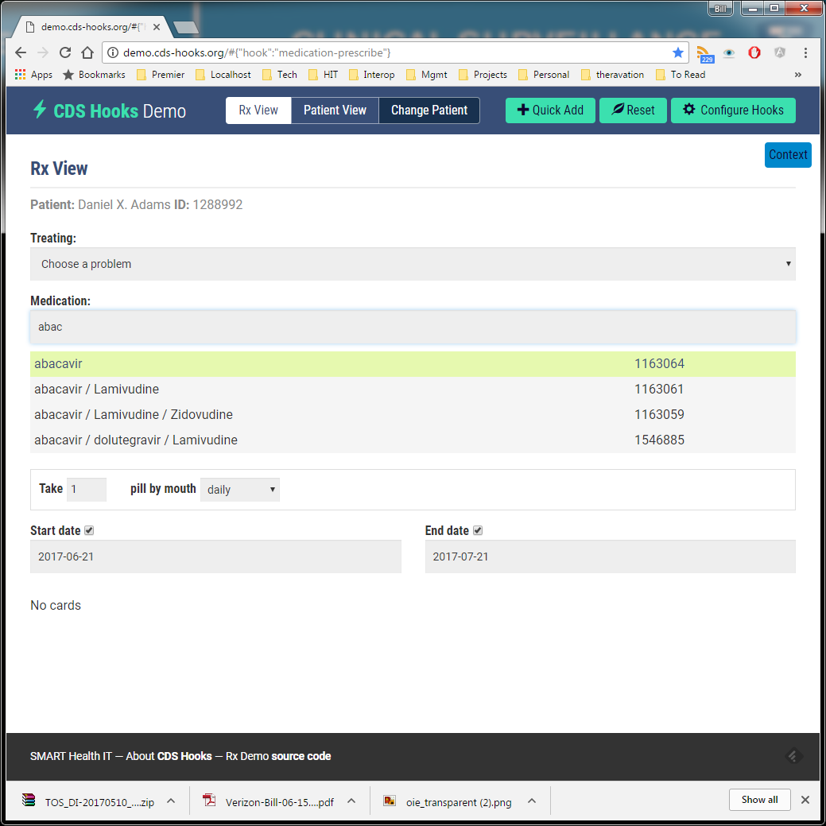

Slide 11
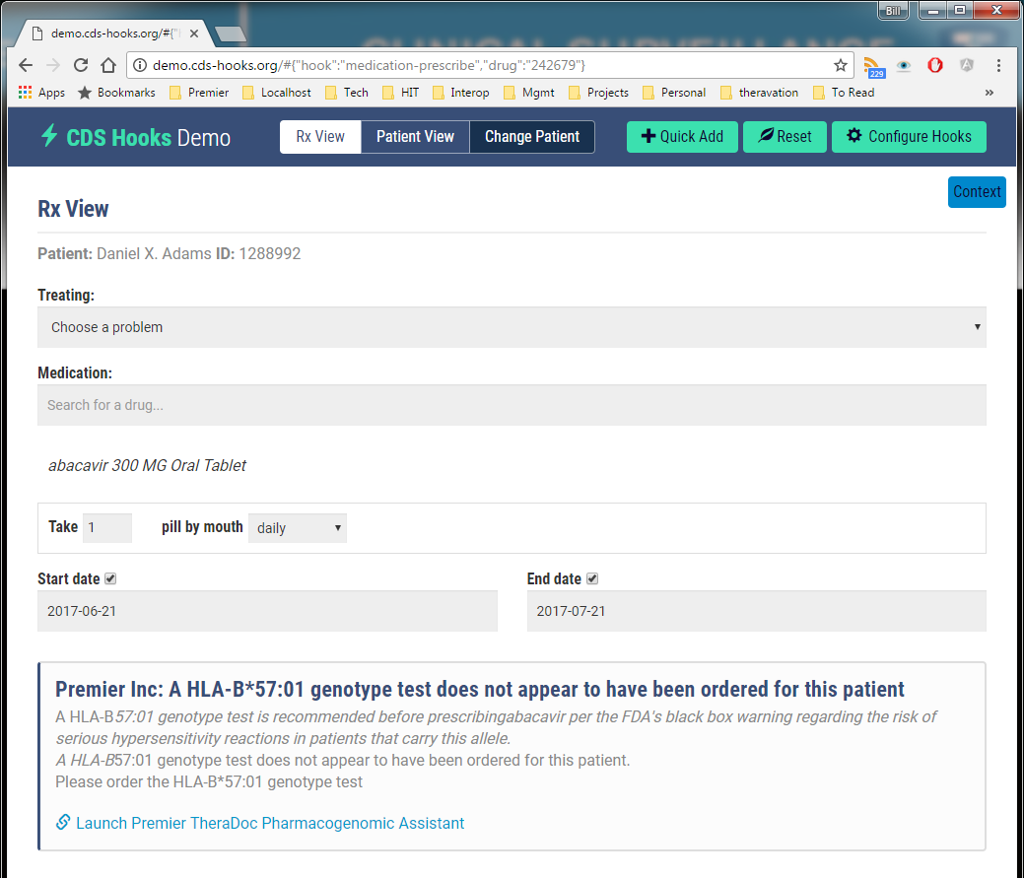

Slide 13
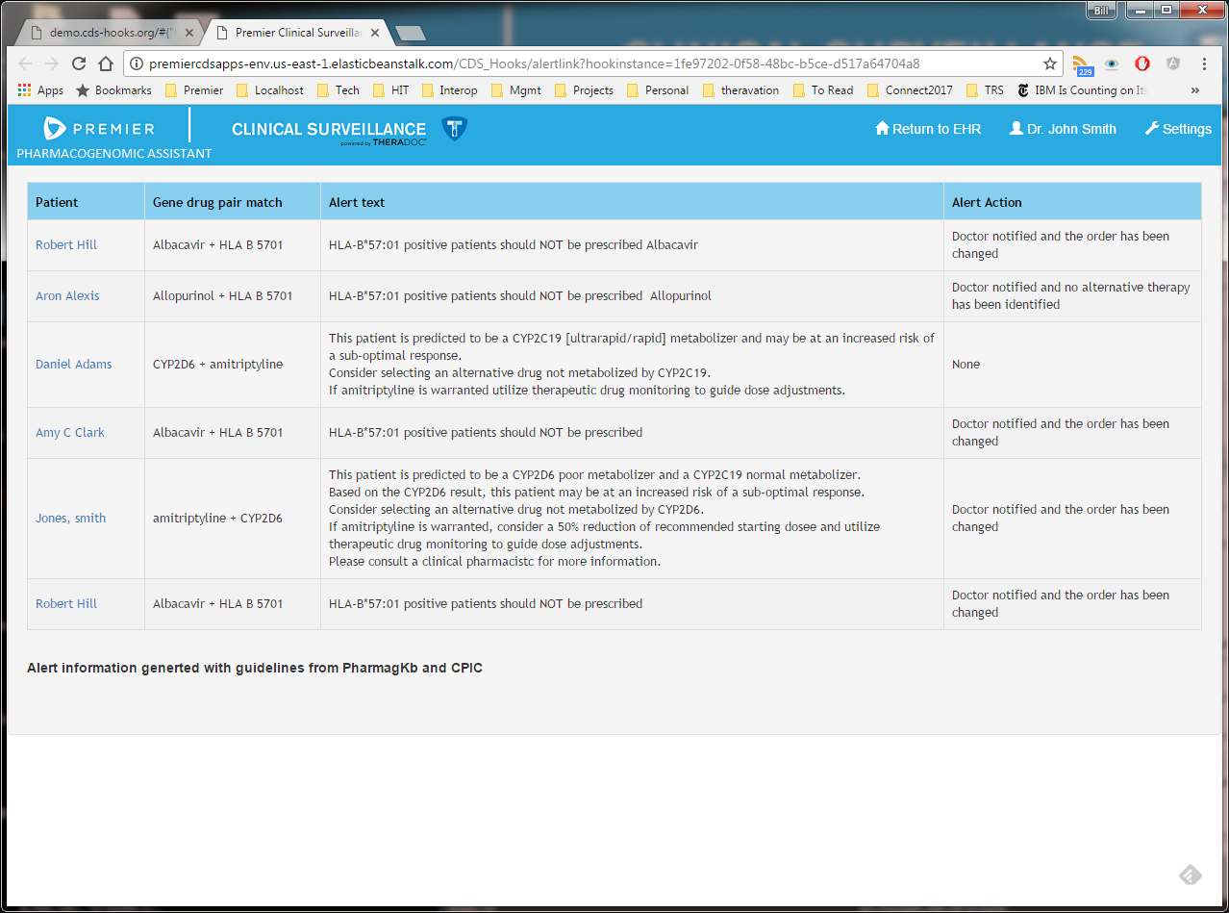

Slide 14
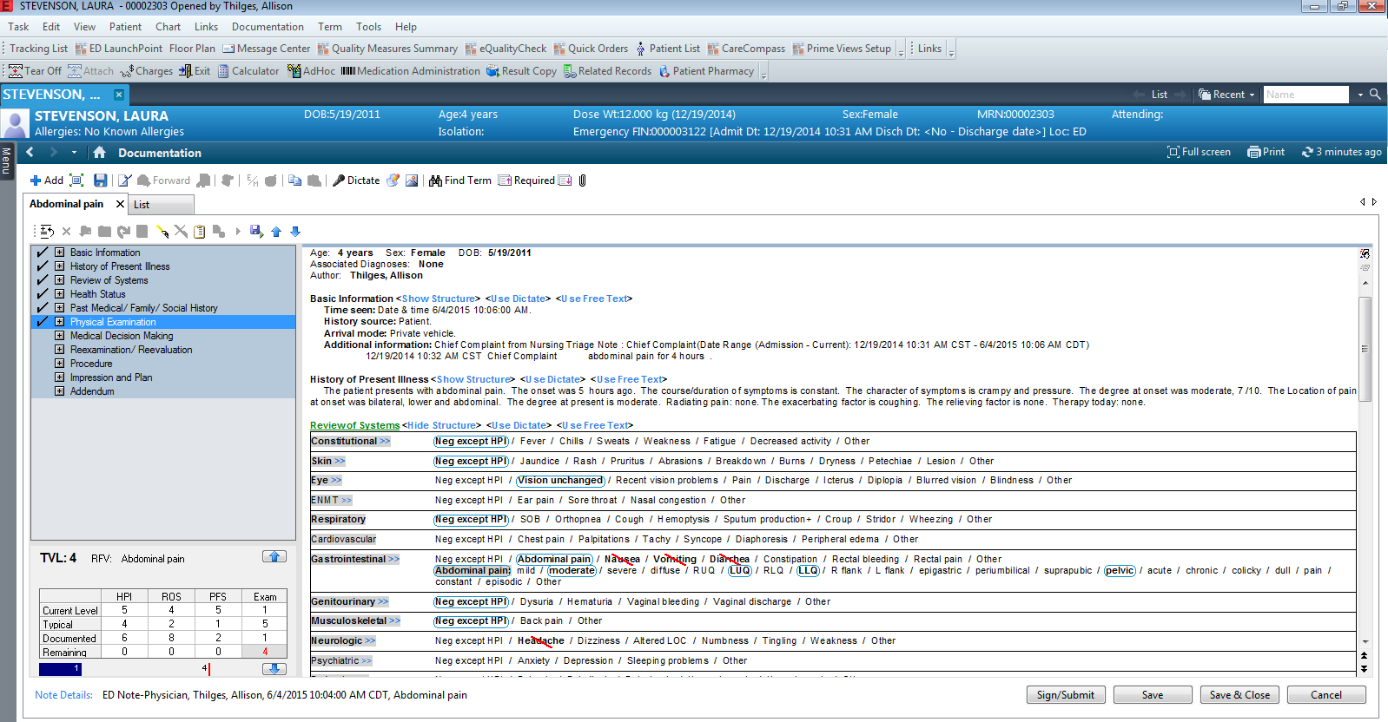
Perfect Choice – a CDS Hooks App

Slide 15
Perfect Choice – a CDS Hooks App
PerfectChoice – ID: New Organism Identified
STEVENSON, LAURA
Age: 4 years CrCl: >100mL/min
Allergies: No Known Allergies SCr: 0.9gm/dL
Previous Admit: 01/18/13
NEW CULTURE INFORMATION
12/22/14 08:45
Specimen ID: 00564783
Status: Prelim
Culture: Blood
Result: E.Coli
ID SUMMARY
Microbiology
012/20/14 Urine Culture: E.coli
Antibiotic Medications:
01/24/13 – 01/25/13 Amoxicillin-clavulanate 150mg PO q8h
Flags:
Community-acquired infection
Isolation
NHSN Documentation:
None
PerfectChoice OPTIONS
Premier Memorial Hospital – Last 12 mos.
E.Coli - Specimen Source Blood
Antibiotic Medications (% Susceptible)
Ampicillin-Sulbactam (93%)*
Levofloxacin (88%)*
Cefazolin (79%)*
SMX-TMP (76%)*
Gentamicin (73%)*
Dismiss
Change Orders

Slide 16
Thankyou!

