Slide 1
Medication management for adherence
Rachel Petersen
SMARTIT

Slide 2

ENABLING
the Best Prescription Decisions
Our mature network’s massive scale fuels industry-leading technologies and insights that help healthcare professionals make the
best prescription decisions and use data to increase patient safety and quality
at a lower cost.
Copyright © 2017 by Surescripts, LLC. All rights reserved.

Slide 3

Addressing non-adherence is core to our mission of driving effectiveness and efficiency across the medication lifecycle
+
Medication consultation and assessment
Medication therapy
Pharmacy fill & additional services
Provider-patient engagement
Medication lifecycle
What we do
Enable more informed care through visibility into a patient’s medication regimen
Provide formulary transparency at point of prescribing, while driving efficiency in script writing
Enable receipt and request change of script at pharmacy. Additional pharmacy services
Enable proactive patient outreach through delivering of population-level information
How we deliver
Medication Management for Adherence
Eligibility
Routing
CompletEPA
RxChange
Panel Management

Slide 4
Our three integration options offer flexibility for our EHR partners
<12 weeks
3
Native
Web services²
2
SMART App
TIME TO IMPLEMENT¹
Surescripts hosted UI
Web App³
1
Accelerator
<6 weeks
“Plug & play”
CONFIGURABILITY
REQUIREMENTS
Full customization
1) Based on initial assessments with early partners; 2) EHR brings in content through a series of web services calls; 3) Surescripts hosts Web App embedded in EHR application using web browser controls or iFrame and provides end-user UI to respond to medication adherence messages and to view medication adherence profile (PDC)
Notes:
Accelerator:
Secure connection – not available to the broader internet
Will want to highlight that implementation is even easier/cheaper if CompletEPA is implemented (up to 2 wks)
Without Accelerator implemented (up to 6 wks)
Native:
Vendor parses data elements from messages and renders them in their own UI
Follow loose guidelines
Up to 12 weeks
SMART:
Container: Entirely uses Surescripts UI
Estimated: up to 12 weeks* → “Current estimate based on initial development/assessment discussions with partners.”

Slide 5
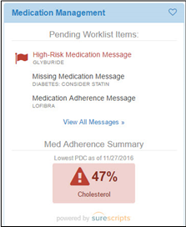

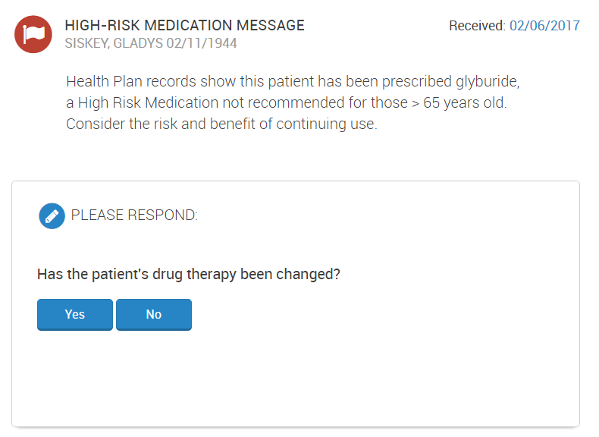

We empower providers with actionable intelligence on medication regimens for their patients to deliver more informed care
Key insights¹
Description
Example content
Adherence summaries
Shows visual snapshot of how adherent a patient is to their maintenance medications based on PDC score²
Medication Adherence
Indicates that a patient may not be taking a medication as frequently as prescribed
Missing Medications
Indicates that an expected medication is not prescribed based on the patient’s diagnosis code
High Risk Medications
Indicates that a patient may be taking a drug that may not be suitable based on side effects
1) Additional insights may include benefit-driven prescription savings opportunities and insights around potential controlled substance abuse. 2) PDC = Proportion of Days Covered

Slide 6
How Surescripts delivers payer insights within the EHR workflow
Payer
Adherence Summaries
EHR
Portion of Days Covered Ratios
  Adherence profiles for specific diseases
Patient-Specific Messages
Patient-Specific Messages
Provider
Responses
Provider
Responses
PBMs deliver valuable information and interaction at critical points in the care process
FHIR¹ standard improves interoperability by standardizing integration of local and network data
EHRs seamlessly integrate new functionality into the workflow of the physician

Slide 7




Use Case: John isn’t taking his hypertension medication
John is a diabetic with hypertension and visits Dr. Smith, his PCP
While reviewing the Patient Chart, Dr. Smith identifies an adherence issue for John’s statin medication
Dr. Smith informs John of correct dosage, and John promises to use as prescribed
Triggered by his visit, John’s adherence summary and msgs are sent into the Patient Chart of Dr. Smith’s EHR
During discussion with John, Dr. Smith learns that John is unaware of correct dosage

