Slide 1
SMART Precision Cancer Medicine
Jeremy Warner MD, MS
Assistant Professor of Medicine and Biomedical Informatics
Vanderbilt University
June 26, 2017

Slide 2
Three questions every cancer patient asks
Who’s like me?
How long have I got?
What are my options?

Slide 3
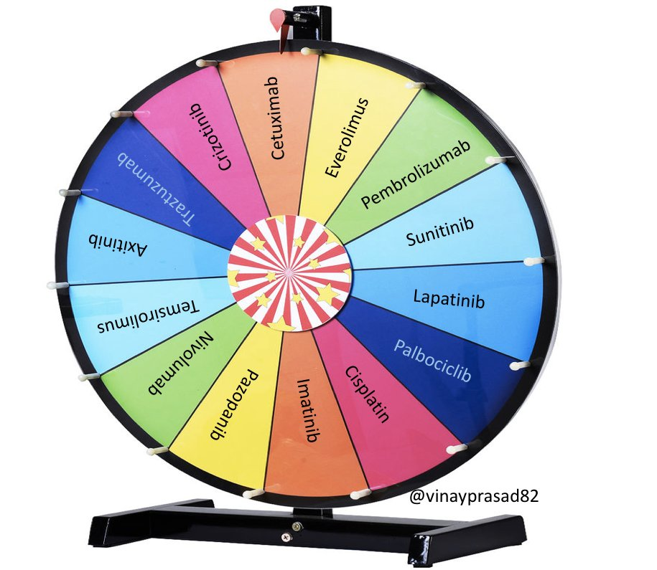
Current state
Who’s like me?
How long have I got?
What are my options?

Slide 4
No Data – No tools!
Poll of ASCO membership, 2016

Slide 5
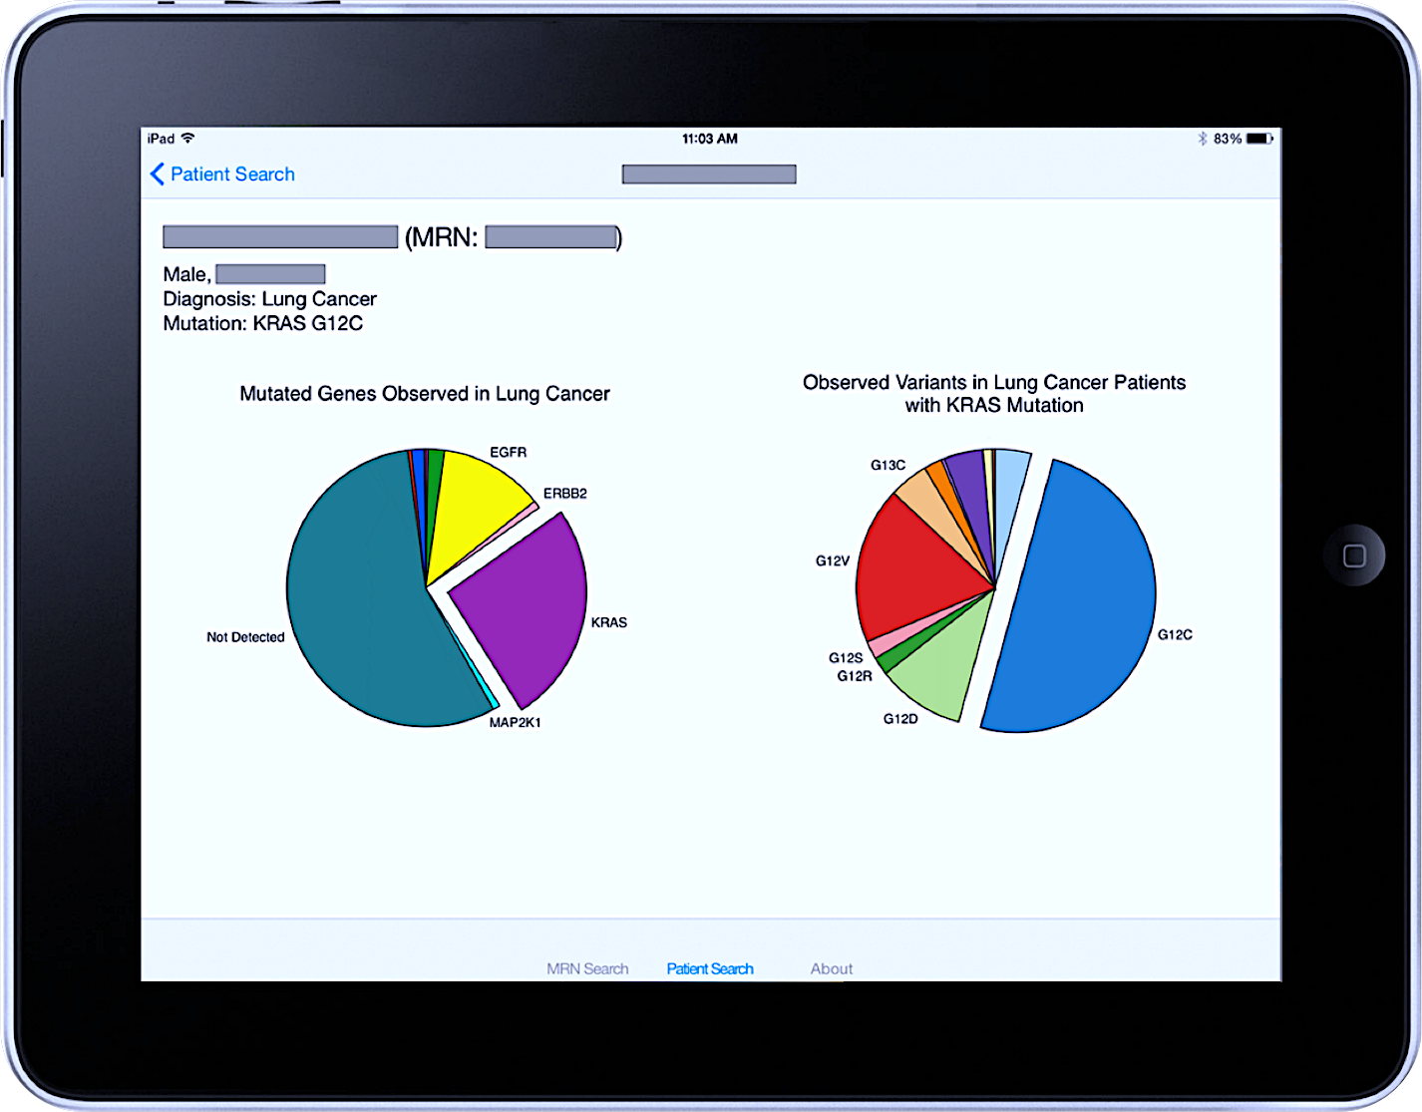
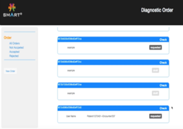
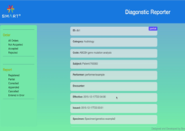
FHIR-enabled workflow
EHR/
Clinical
Systems
1
Order
Genetic Tests
3
Present & Contextualize
Genetic Test Results
SMART on FHIR
Clinico-Genomics Apps
Diagnostic Order App
Diagnostic Reporter App
FHIR®
Data
FHIR®
Data
Sequencing
Lab
SMART Precision Cancer Medicine App
2
Return
Genetic Test Results
Warner et al. Genome Med 2016

Slide 6
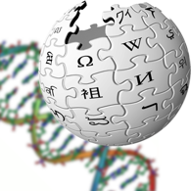
SMART Precision Cancer Medicine
Warner et al. JAMIA Precision Medicine Special Issue 2016
Notes:
Purpose: to present real-time population-level genomic health information to oncologists and their patients, as a component of clinical practice
Means: an open-source application based on the SMART on FHIR Genomics API for native data representation of somatic genomic data
Secondary Objective: demonstrate the ease of including seamless links to external knowledge bases within the app

Slide 7
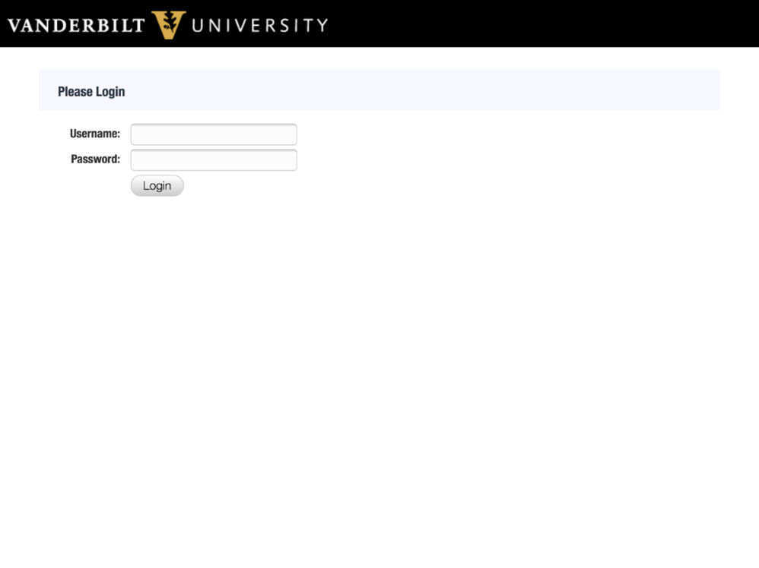
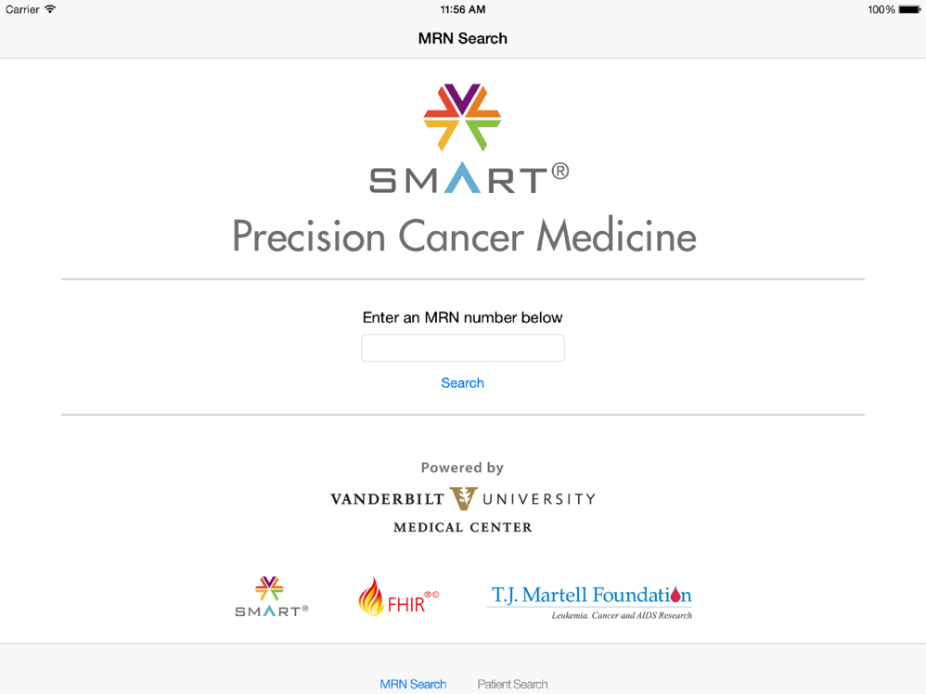
Warner et al. JAMIA Precision Medicine Special Issue 2016

Slide 8
“Patients Like This”
This patient has the most common variant of KRAS seen in the lung cancer population.

Slide 9
In this exploded view, the user can see enumerated information as well.

Slide 10
The user can access Gene Wiki information about the gene, directly from the exploded gene view

Slide 13
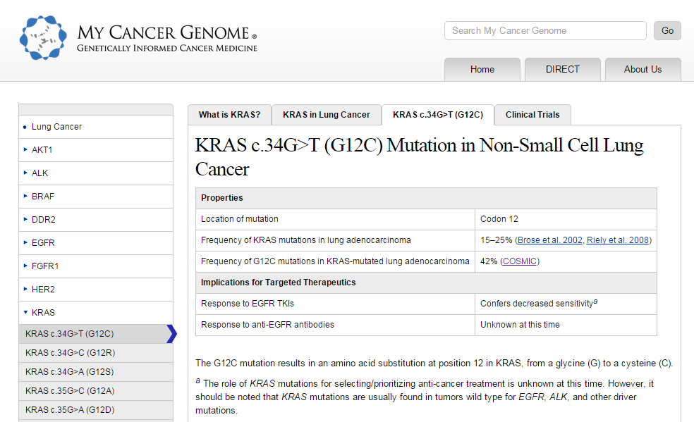
The user can access MyCancerGenome information about the gene variant, directly from the exploded gene variant view
“What are my options?”

Slide 14
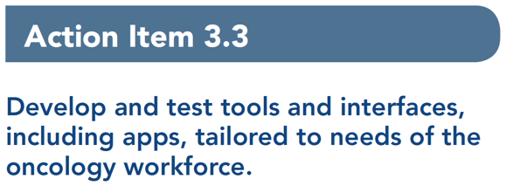

Slide 15
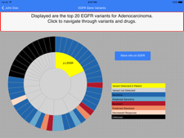
Under the hood
LDAP SSO
SMART PCM
Security Module
Authentication
Authorization
Genome Knowledge Module
Education
Prognosis
Genome-directed therapy
HIS
Patient Data Module
Demographics
Cancer data
NGS panel data
Regimen Knowledge Module
Education
Efficacy
Toxicity
Presentation Module
“patients like this”
genomic therapy
treatment ranking

Slide 16
Unpublished work, Krysten Harvey

Slide 17
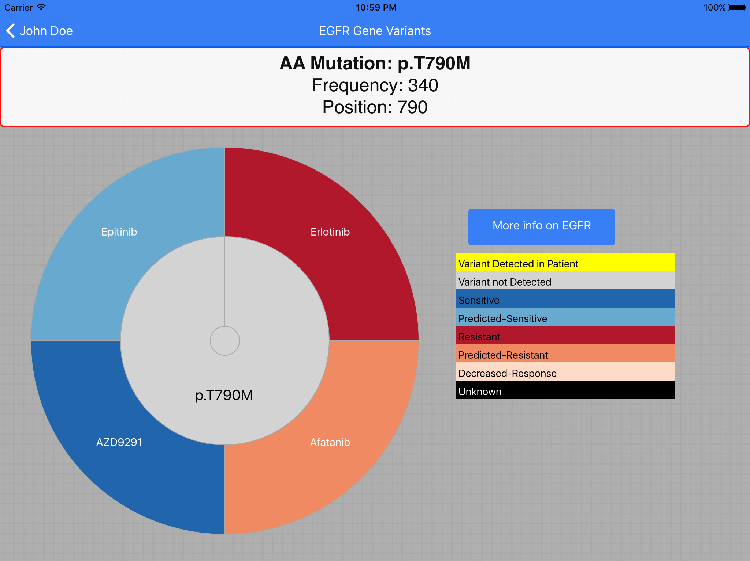
Unpublished work, Krysten Harvey

Slide 18
Acknowledgements
Gil Alterovitz
Joseph Burden
Daniel Carbone*
Tom Chen
Jake Conway
Krysten Harvey*
Sandeep Jain
Isaac Kohane
David Kreda
Andrew Malty
Josh Mandel
Ken Mandl
Ross Oreto*
Travis Pittman
Matthew Rioth
Joey Schneider
Nipun Sud
Ari Taylor
Lucy Wang*
Daniel Wenner
Heming Yao*
Peter Yang
Peijin Zhang
Shilin Zhu*
Past and current funding support: NCATS ULTR000445, NCI CA068485, CA171123, CA194215, ONC 90TR0001/01, PCORI CDRN-1306-04869, Robert J. Kleberg, Jr. and Helen C. Kleberg Foundation, T.J. Martell Foundation, and an anonymous foundation
* Directly involved in programming of SMART PCM

